Slide 1



SAVEETHA SCHOOL OF ENGINEERING
SAVEETHA INSTITUTE OF MEDICAL AND TECHNICAL SCIENCES
CSA0697 DESIGN AND ANALYSIS OF ALGORITHM FOR LOWER BOUND THEORY
TOPIC:
MINIMUM COST TO REACH DESTINATION IN TIME
FACULTY NAME: Dr.Gnana Soundari
By,
NAME : B. Hemanth Chowdary
REG.NO: 192211206

Slide 2
Minimum Cost to Reach Destination in Time
There is a country of n cities numbered from 0 to n - 1 where all the cities are connected by bi-directional roads. The roads are represented as a 2D integer array edges where edges[i] = [xi, yi, timei] denotes a road between cities xi and yi that takes timei minutes to travel. There may be multiple roads of differing travel times connecting the same two cities, but no road connects a city to itself.
Each time you pass through a city, you must pay a passing fee. This is represented as a 0-indexed integer array passingFees of length n where passingFees[j] is the amount of dollars you must pay when you pass through city j.
In the beginning, you are at city 0 and want to reach city n - 1 in maxTime minutes or less. The cost of your journey is the summation of passing fees for each city that you passed through at some moment of your journey (including the source and destination cities).
Given maxTime, edges, and passingFees, return the minimum cost to complete your journey, or -1 if you cannot complete it within maxTime minutes.
Example 1:
Input: maxTime = 30, edges = [[0,1,10],[1,2,10],[2,5,10],[0,3,1],[3,4,10],[4,5,15]],
passingFees = [5,1,2,20,20,3]
Output: 11
Explanation: The path to take is 0 -> 1 -> 2 -> 5, which takes 30 minutes and has $11 worth of passing fees.

Slide 3
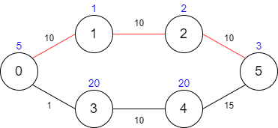

Slide 4
Problem Overview and Approach
Problem Statement:
Navigate a network of interconnected cities with diverse travel times and associated passing fees.
Goal:
Determine the most cost-effective route to reach the destination city within the given time constraint.
Task:
Minimize the total cost incurred while ensuring timely arrival at the destination.
Approach:
Utilize a modified version of Dijkstra's algorithm to consider both time and cost factors during route planning.

Slide 5
Example
Problem Scenario:
Imagine a country with cities connected by roads, each with its own travel time and passing fee.
Example Inputs:
Maximum Time Limit: 30 minutes
Roads Between Cities:
[(0, 1, 10), (1, 2, 10), (2, 5, 10), (0, 3, 1), (3, 4, 10), (4, 5, 15)]
Passing Fees for Each City: [5, 1, 2, 20, 20, 3]
Expected Output:
Minimum cost to reach the destination city within 30 minutes: $11

Slide 6
Solution Approach
Outline:
Utilize a modified version of Dijkstra's algorithm to efficiently solve the problem.
Modified Dijkstra's Algorithm:
Adapt Dijkstra's algorithm to consider both time and cost factors during traversal.
Steps:
1. Start from the source city and initialize a priority queue.
2. Update the minimum cost for reaching neighboring cities considering time and passing fees.
3. Repeat until the destination is reached or no feasible path is available within the time limit.

Slide 7
Implementation
Key Components:
Data Structures: Priority queue (heap), adjacency list for graph representation.
Algorithm: Modified Dijkstra's algorithm.
Functions: Implementation of Dijkstra's algorithm, cost calculation.
Complexity Analysis: Time Complexity: O((V + E) log V), where V is the number of vertices and E is the number of edges.
Space Complexity: O(V), where V is the number of vertices for the priority queue and adjacency list.

Slide 8
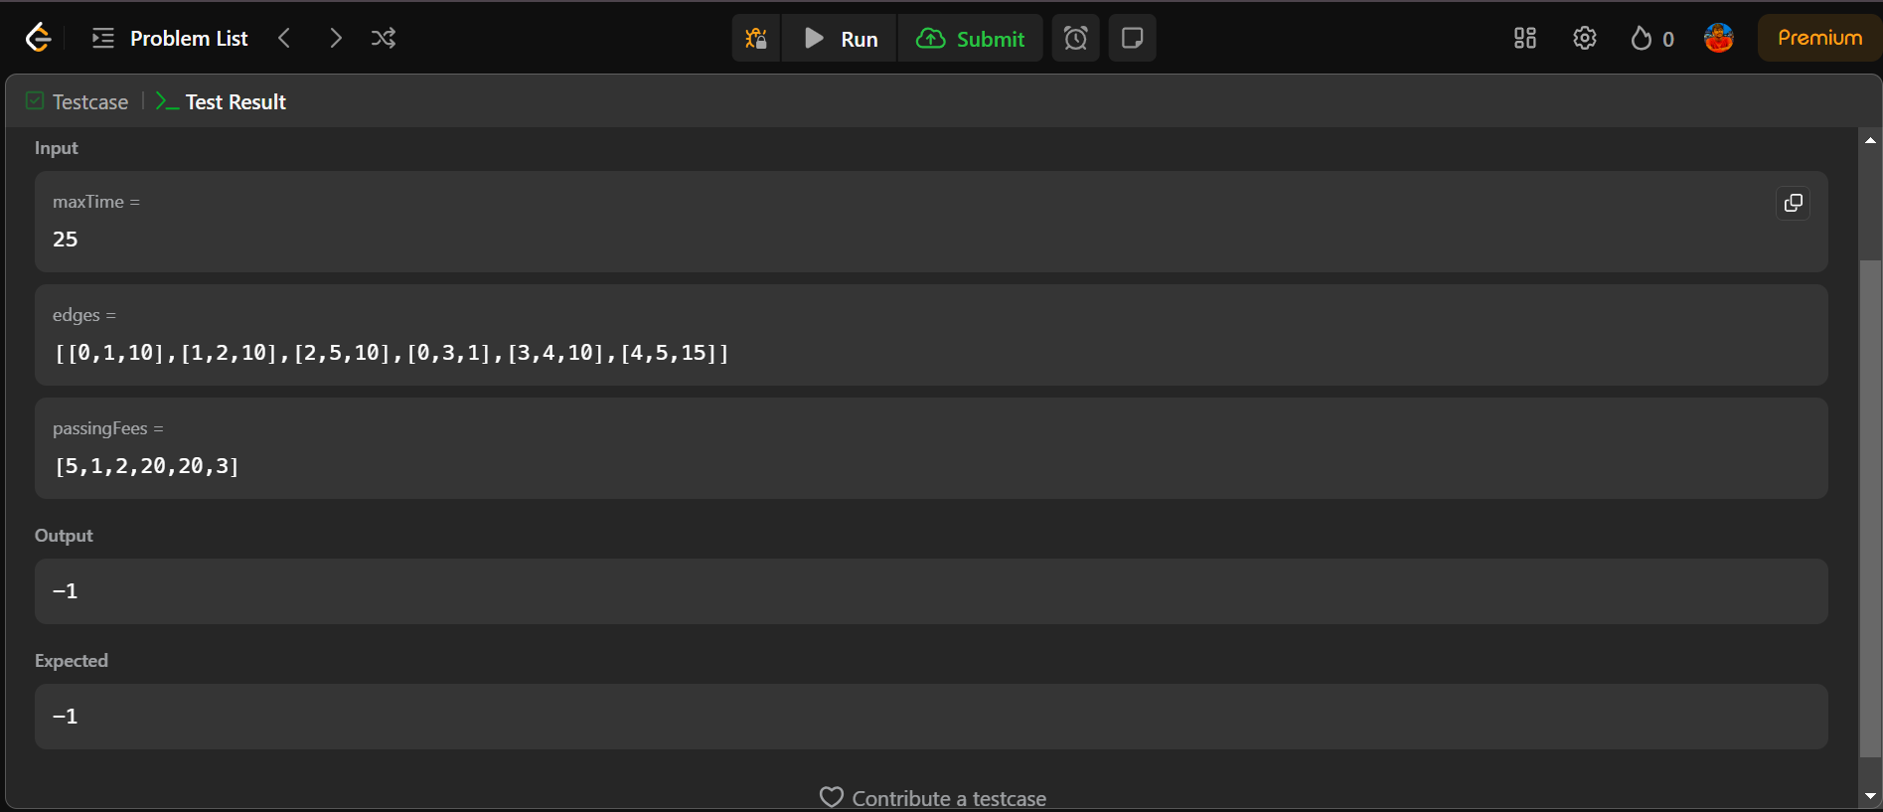

Slide 9
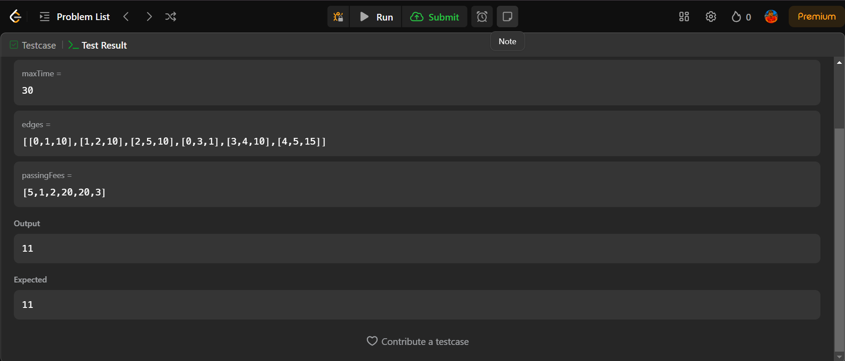

Slide 10
Conclusion
Through the modified Dijkstra's algorithm, we effectively balanced travel time and passing fees to find the optimal route.
This solution offers a practical approach to travel planning, ensuring efficient resource utilization and cost savings.
Further research can explore additional constraints and enhancements to extend the applicability of this approach in real-world scenarios.

Slide 11
THANK YOU

